Slide 1
Balance Personalized Learning in the Classroom
Creek View Elementary
March 2017

Slide 2
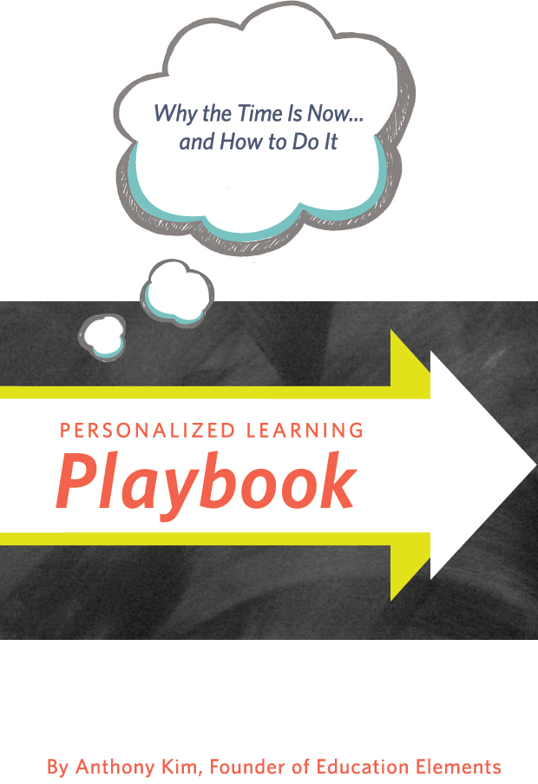
Resource… Personalized Learning Playbook

Slide 3
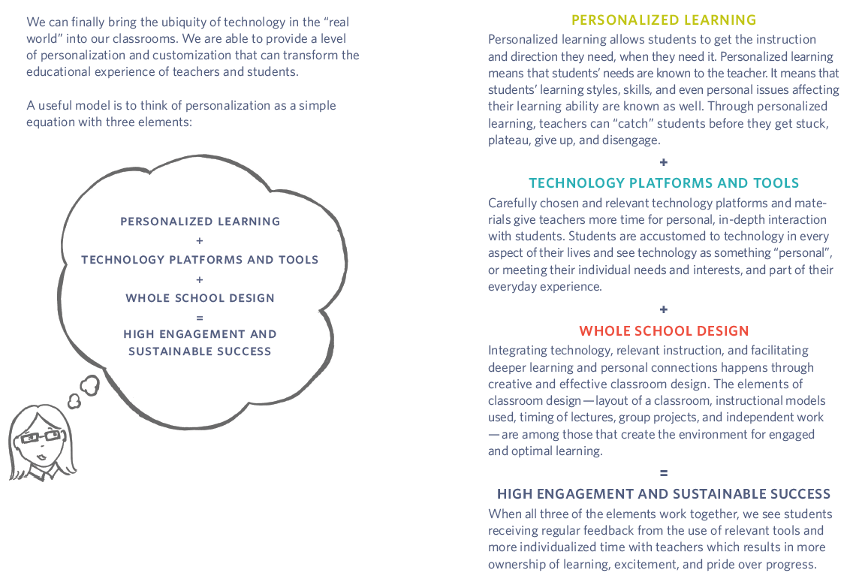

Slide 4
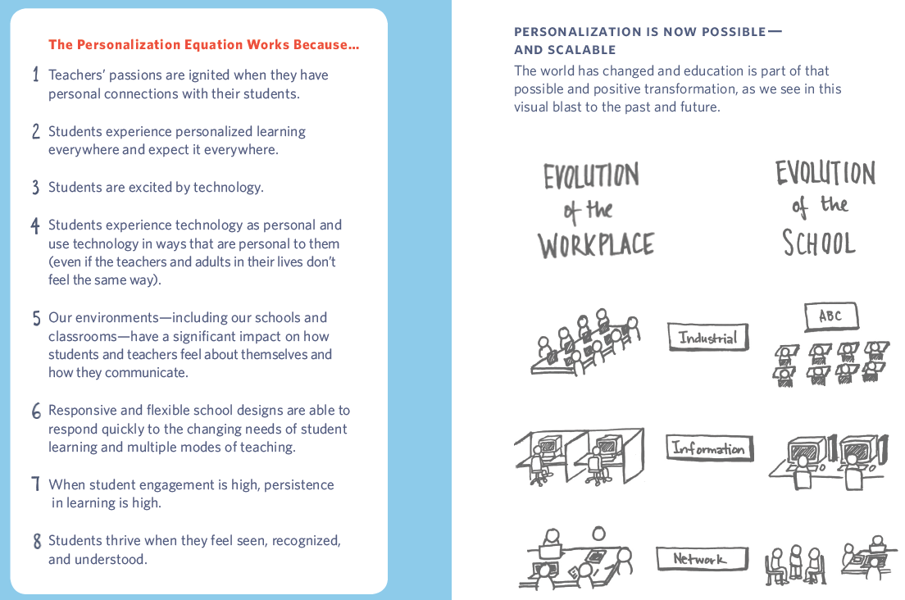

Slide 5
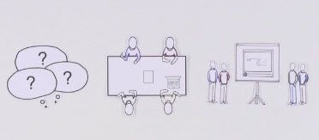
Project Based Learning Explained
https://safeshare.tv/x/ss58ca12fd4e2c5

Slide 6
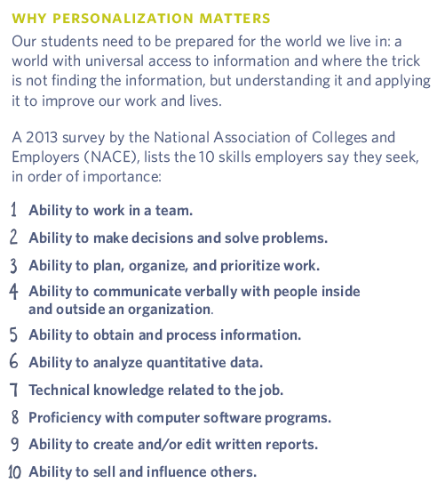
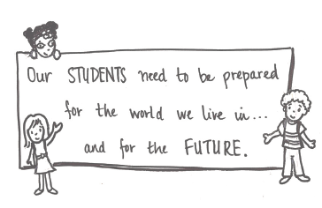

Slide 7
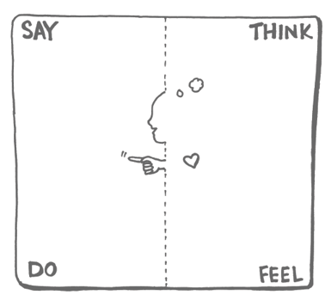
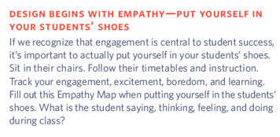

Slide 8
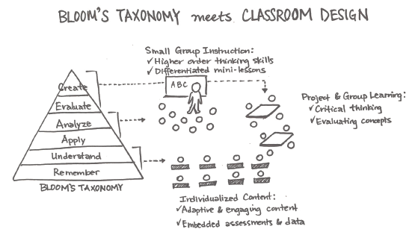
At what level of Bloom’s Taxonomy do you spend most of your time during the school day?
Where would you like to be? Where would your students like to be?

Slide 9
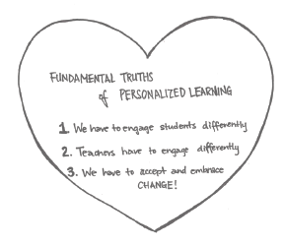
Empathy + Engagement + Interaction =
Sustainable & Achievable Personalized Learning

Slide 10
Eye of the Tiger vs. Charlie Brown
Source: What to Expect When You’re Project Based Learning

Slide 12
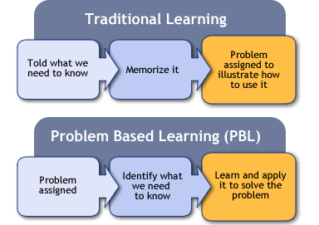

Slide 14
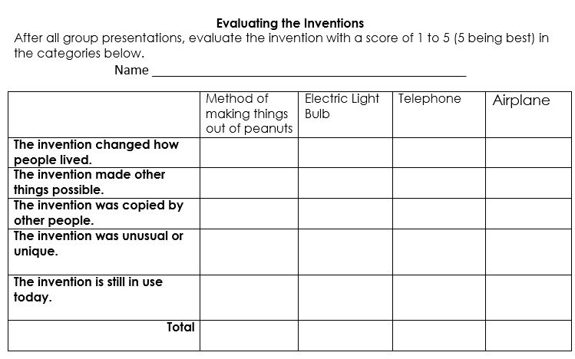
Feedback, Evaluate, & Reflection

Slide 15
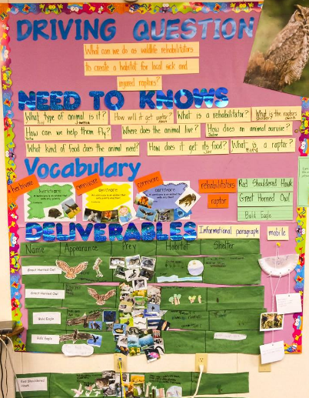
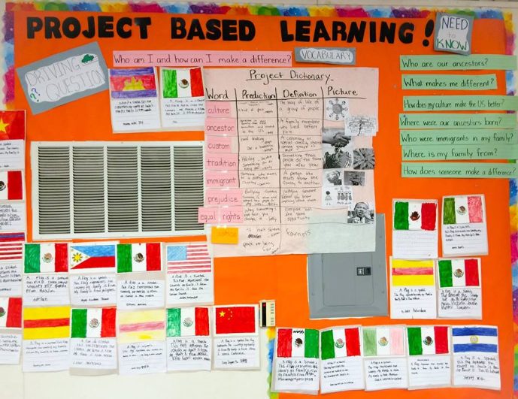
Project Wall

Slide 16
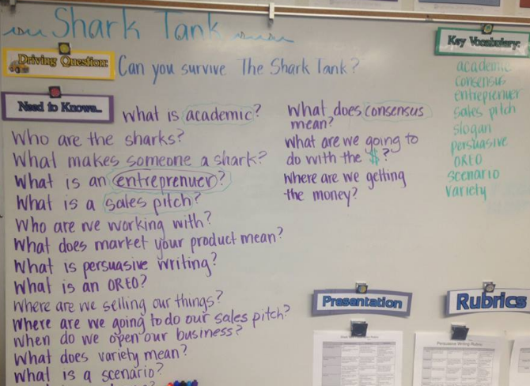
Project Wall – 3rd Grade

Slide 17
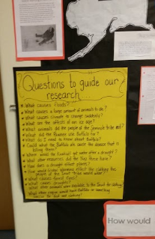
Questions to Guide our Research

Slide 18
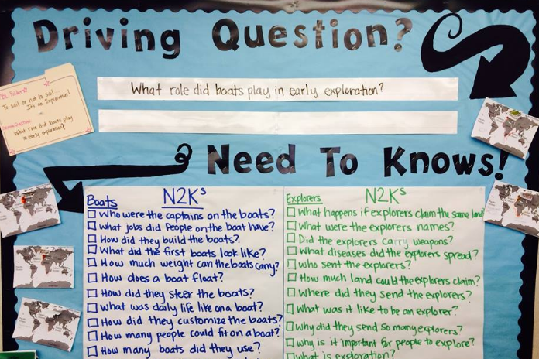
Project Wall – 5th Grade

Slide 19
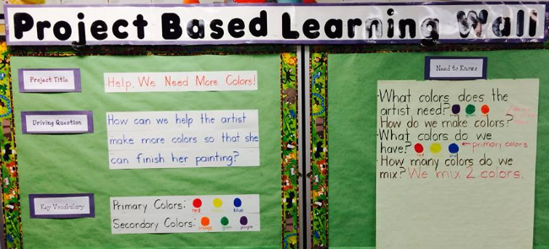
Project Wall - Art

Slide 20
Phase One: Permits Phase Two: Design & Build Phase Three: Construction Phase Four: Building Up Phase Five: Assessment Phase Six: Tourism

Slide 21
Explore…
Go to cvesidealab.weebly.com
PBL Examples
Explore the resources on the page – 10 minutes
After the explore time…
Share one idea you can add next year
Something you will change for improvement from this year.

Slide 22
PBL Twitter Hashtags
#PBLchat
#pbl

Slide 23
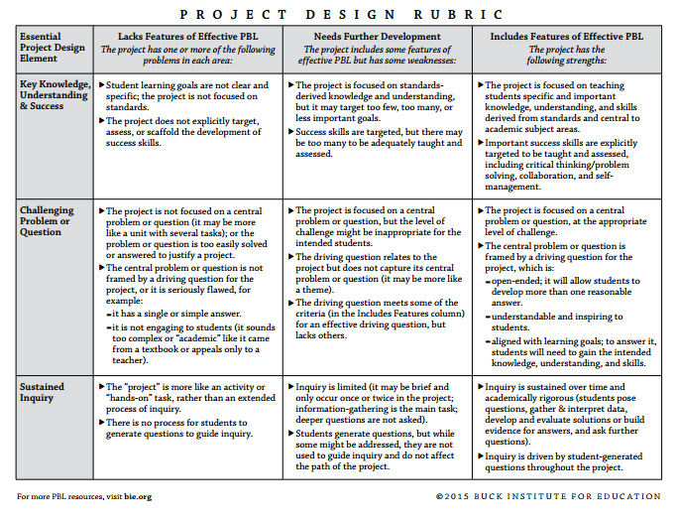
Reflection – work together as a team to fill out the PBL rubric for your 2nd unit.

Slide 24
https://drive.google.com/open?id=0ByNXNcjRFKnAQnB2UnR0UnN6LXc

Slide 25
PBL Museum – May 4, 2017
DAY
Grade Level Times
Schedule to visit other grade level (s)
NIGHT
5:30-7:00
Environment and Presentation
Display all parts of PBL Unit
Bulletin Board in middle of classes should have PBL elements
Students should have specific roles and a place to be when in your class
Set expectations and practice presentations
Sign-Up Genius if you want
Set specific times for groups to come together

Slide 26
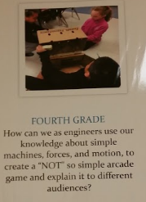
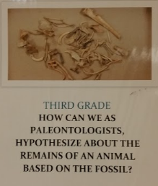
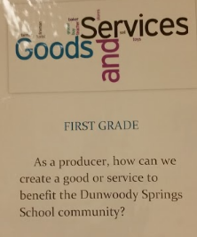

Slide 27
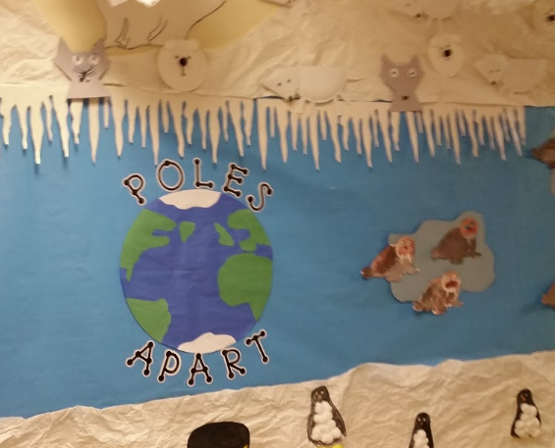
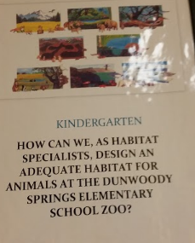
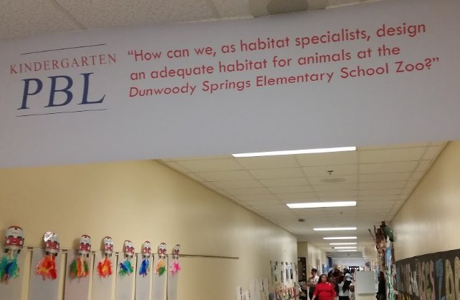
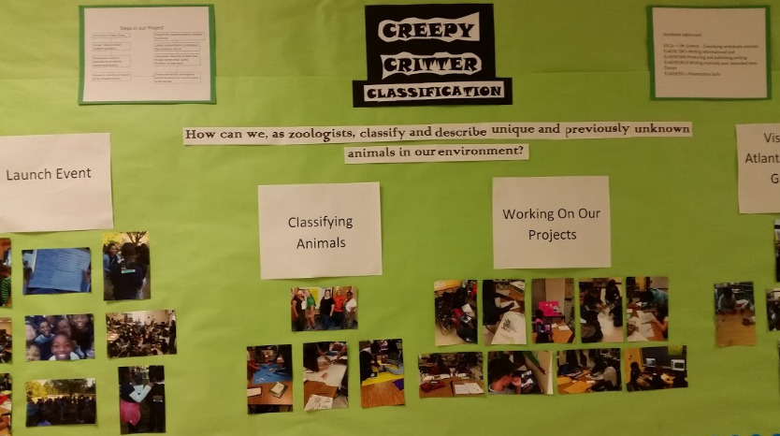
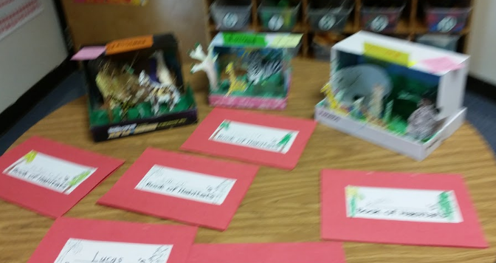

Slide 28
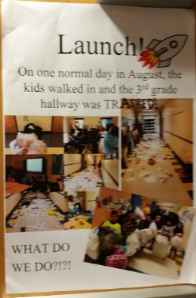
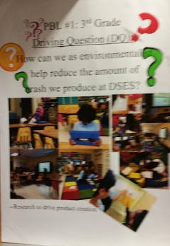
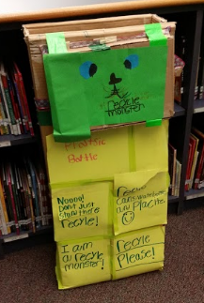
3rd Grade - Pollution

Slide 29
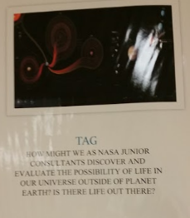
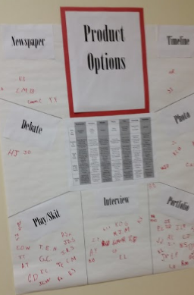
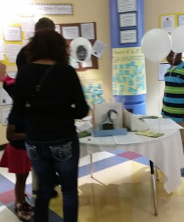

Slide 30
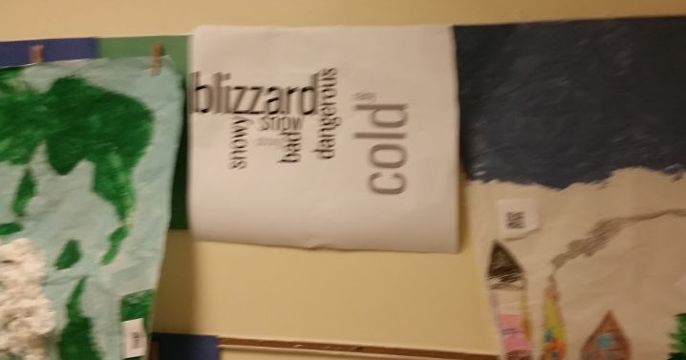
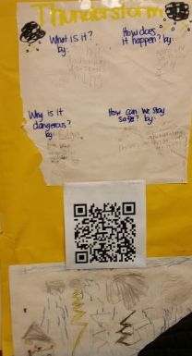
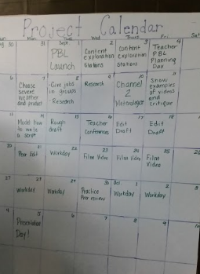
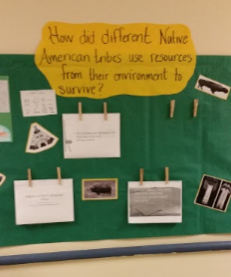

Slide 31
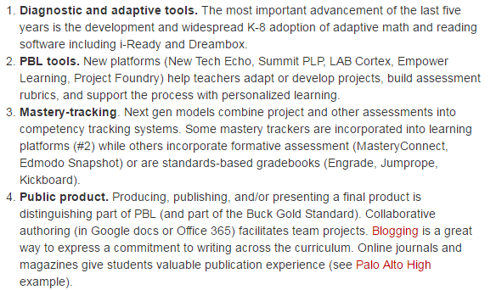
What’s Next? Personalized, Project Based Learning

Slide 32
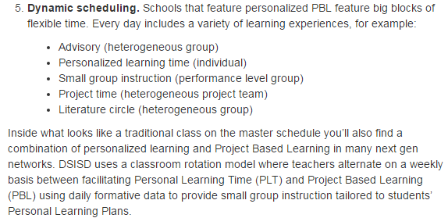

Slide 33
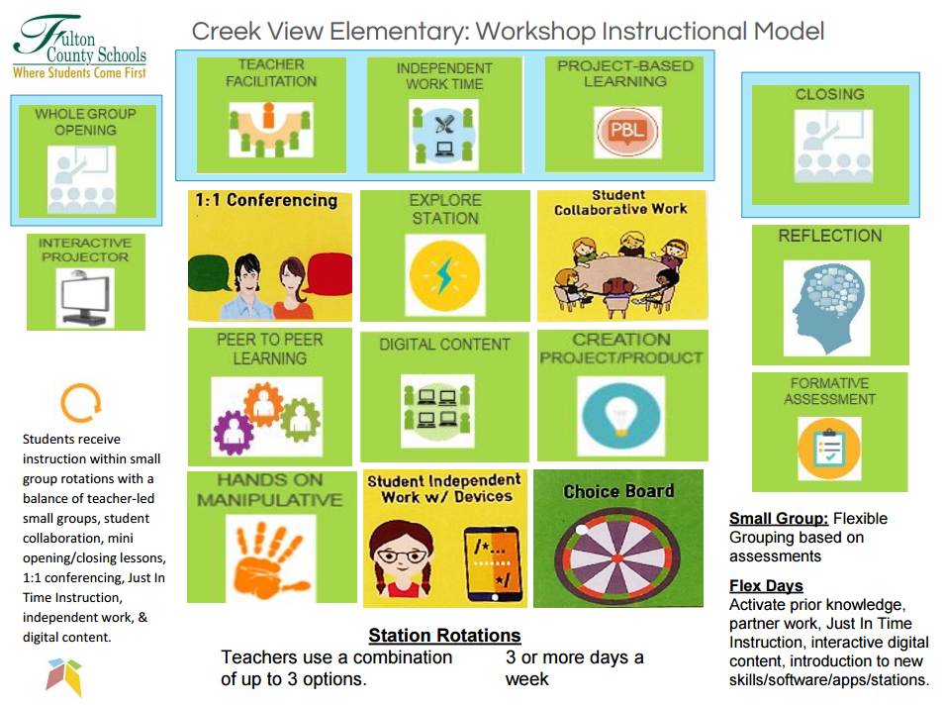

Slide 36
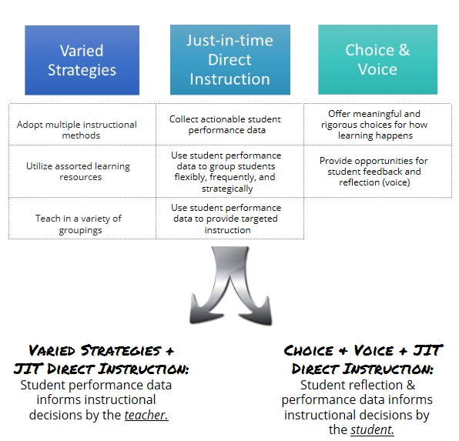

Slide 37
Workshop Rotation Activities – Media Center
Small Group w/Gower – Forming Groups and Activities
CVES Strategy Bank Choice Board (Hamilton)
Flipped Classroom Style & Tech Exploration (Wade)
Digital Portfolios
K-2, Seesaw School Edition (Tanis & Leigh - iTeach )
3-5, Office 365 (Tanis – iTeach)

Slide 38
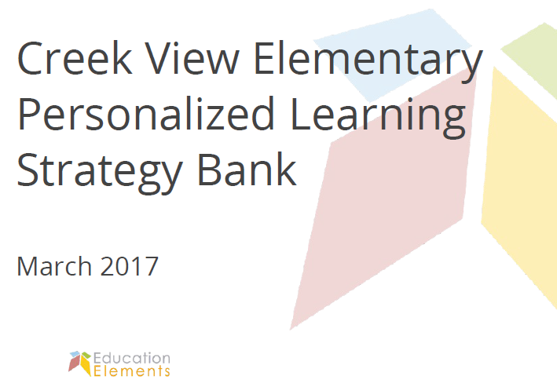
CVES Strategy Bank Choice Board
1. Independent Work
Category Breakdown
Targeted small-group instruction
Student Reflection & Ownership
Data-Driven Decisions

Slide 39
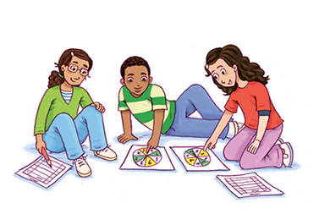
2. Small Group w/Gower
Groups, Goals, Growth
Just-in-time Direct Instruction
Ways to gather assessment data
How to group students
Classroom interventions

Slide 40
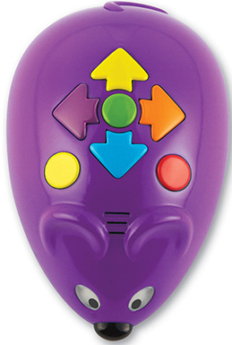
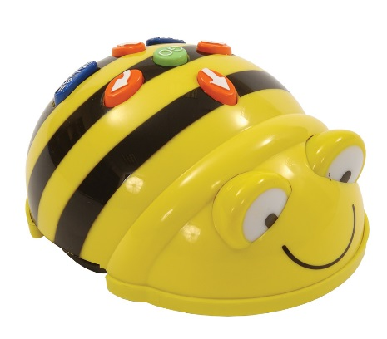
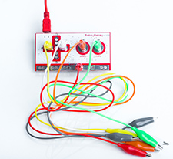
3. Technology Exploration Stations

Slide 41
Workshop Model PD
 | Teacher | Independent | Work Station
Rotation 1 | K | 1st | 2nd
Rotation 2 | 2nd | K | 1st
Rotation 3 | 1st | 2nd | K
ESOL w/ K, EIP w/1st

Slide 42
Workshop Model PD
 | Teacher | Independent | Work Station
Rotation 1 | 3rd | 4th | 5th
Rotation 2 | 5th | 3rd | 4th
Rotation 3 | 4th | 5th | 3rd
TAG w/ 5, Art/Music w/4th, PE w/3rd

